Slide 1
CARDIOVASCULAR SYSTEM
Dr. Hanaa Salman Kadhum
Pathological Analysis Department
Collage of Science

Slide 2
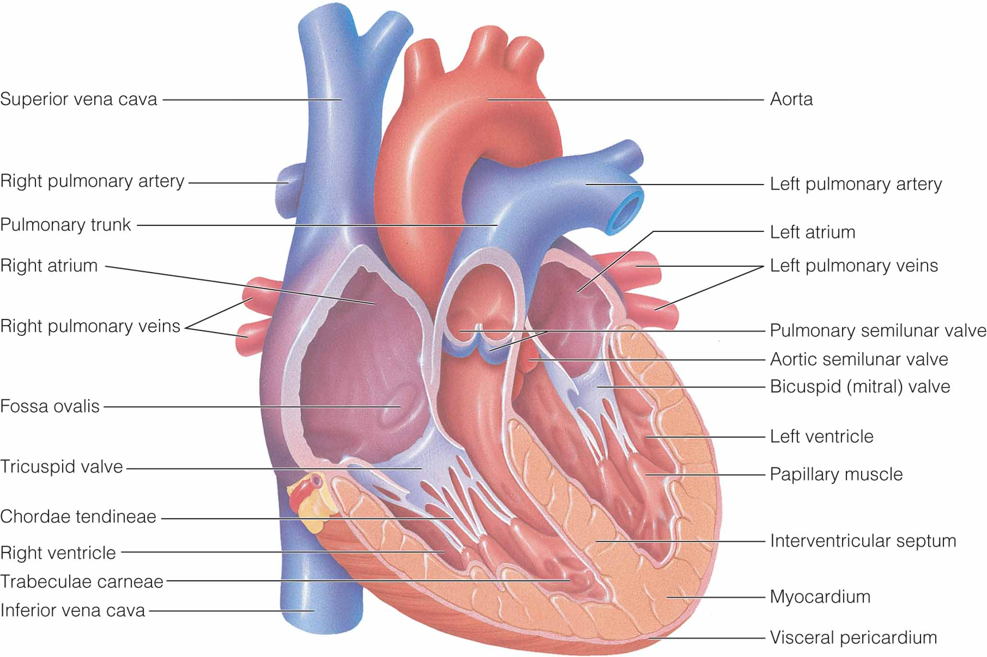
Structural components of the heart.
Notes:
2

Slide 3
Cardiovascular System Components
Circulatory system
Pulmonary system
Purposes:
Transport O₂ to tissues and remove waste
Transport nutrients to tissues
Regulation of body temperature

Slide 4
Circulatory System
Heart
Pumps blood
Arteries and arterioles
Carry blood away from heart
Capillaries
Exchange nutrients with tissues
Veins and venules
Carry blood toward heart

Slide 5
Pulmonary and Systemic Circuits
Systemic Circuit
Left side of heart
Pumps oxygenated blood to body via arteries
Returns deoxygenated blood to right heart via veins
Pulmonary Circuit
Right side of heart
Pumps deoxygenated blood to lungs via pulmonary arteries
Returns oxygenated blood to left heart via pulmonary veins

Slide 6
Pulmonary and Systemic circulations

Slide 7
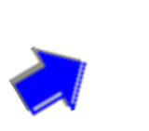
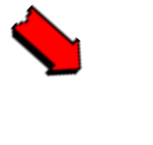
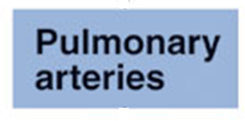
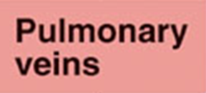
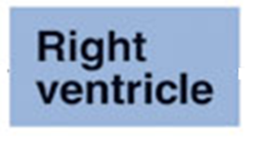
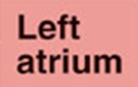
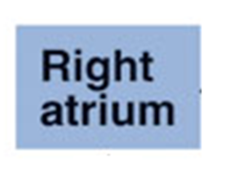
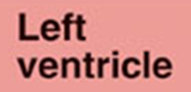
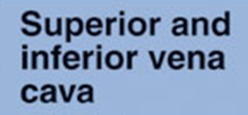
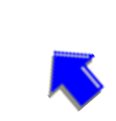
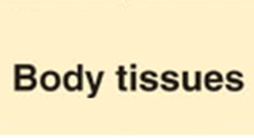
Pulmonary circulation
Systemic circulation

Slide 8
Functional anatomy of heart
The heart is a muscular pump designed to ensure the circulation of blood
through the tissues of the body. The human heart weighs approximately
300 g and it consists of two halves, right and left, both structurally and
functionally. The right half circulates blood through the lungs for the
purpose of oxygenation (i.e. through pulmonary circulation). The left
heart circulates blood to tissues of the entire body (i.e. through the
systemic circulation).
Chambers of heart
Each half of the heart consists of an inflow chamber called the atrium and
an outflow chamber called the ventricle . Thus, there are four
chambers in the heart.

Slide 9
Atria
• Interatrial septum separates the right and left atria which are thin walled
chambers.
• Right atrium receives deoxygenated blood from tissues of the entire
body through the superior and inferior venae cava. This blood passes
into the right ventricle through the right atrio-ventricular orifice which is
guarded by tricuspid valve. The right atrium has got the pacemaker
known as sinoatrial node that produces cardiac impulses and
atrioventricular (AV) node that conducts these impulses to the
ventricles.
• Left atrium receives oxygenated blood from the lungs through the four
pulmonary veins (two rights and two lefts). This blood passes into left
ventricle through the left AV orifice which is guarded by the mitral
valve.

Slide 10
Ventricles
• Interventricular septum separates the right ventricle from left ventricle.
• Interior of each ventricle has an inflow part and an outflow part. The
inflow part of each ventricle is a rough inner surface because of the
presence of numerous bundles of cardiac muscles called trabeculae
carnae. Papillary muscles are finger-like processes attached to the
ventricular wall at one end, but free at the other. They are functionally
related to the AV valves.
• Right ventricle receives blood from the right atrium and pumps
through the pulmonary trunk (which divides into right and left
pulmonary arteries) into the lungs. The pulmonary valve is present at
the junction of right ventricle and pulmonary trunk.
• Left ventricle receives blood from the left atrium and pumps out into
systemic circulation through the aorta. Aortic valve is present at the
junction of left ventricle and the ascending aorta.

Slide 11
Valves of heart
There are four valves in human heart, two AV valves and two semilunar
valves. Valves allow unidirectional flow of blood.
AV valves
The AV valves open towards the ventricles and close towards the atria.
They allow blood to flow from atria to ventricles. But when ventricles
contract, they are closed, and thus prevent backflow of blood from
ventricles to atria.
• Right AV valve is known as tricuspid valve and is made of 3 cusps:
anterior, posterior and septal.
• The left AV valve is called mitral valve or bicuspid valve and is made of 2
cusps: anterior and posterior.
• At the periphery, the cusps (flaps) of the AV valves are attached to the
AV ring, which is a fibrous connection between the atria and ventricles.
The free edges of the cusps are attached to papillary muscles through the
cord-like structures called the chordae tendineae.

Slide 12
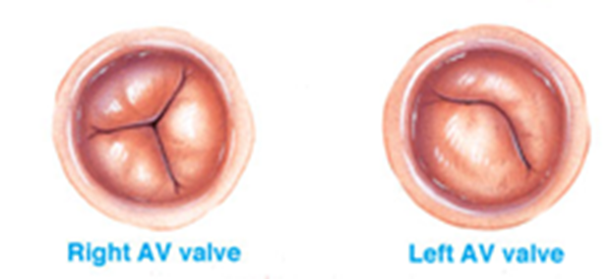
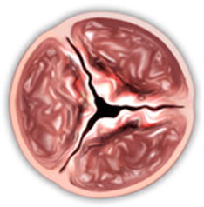
• Papillary muscles arise from the inner surface of ventricles and
contract when the ventricular walls contract. They do not help the
valves to close but prevent the bulging of the valves into the atria
when ventricles contract. Therefore, in the event of paralysis of
papillary muscles or rupture of chordae tendineae the AV valve bulges
(into the atria), and there occurs regurgitation of blood into the atria
during systole when ventricles contract.
Aortic or polmunary valve

Slide 13
Semilunar valves
• Aortic valve is the semilunar valve present at the opening of aorta in
left ventricle. It is made of three semilunar cusps: one anterior and two
Posterior.
• Pulmonary valve is the semilunar valve present at the opening of pulmonary trunk into the right ventricle. It is also made of three
semilunar cusps: one posterior and two anterior.
• Semilunar valves open away from ventricles and close towards the ventricles. These valves open when ventricles contract allowing the blood to flow from left ventricle to aorta and from right ventricle to pulmonary trunk.
• Semilunar valves close when ventricles relax, thus preventing
backflow of blood from aorta or pulmonary trunk into the ventricles.

Slide 14
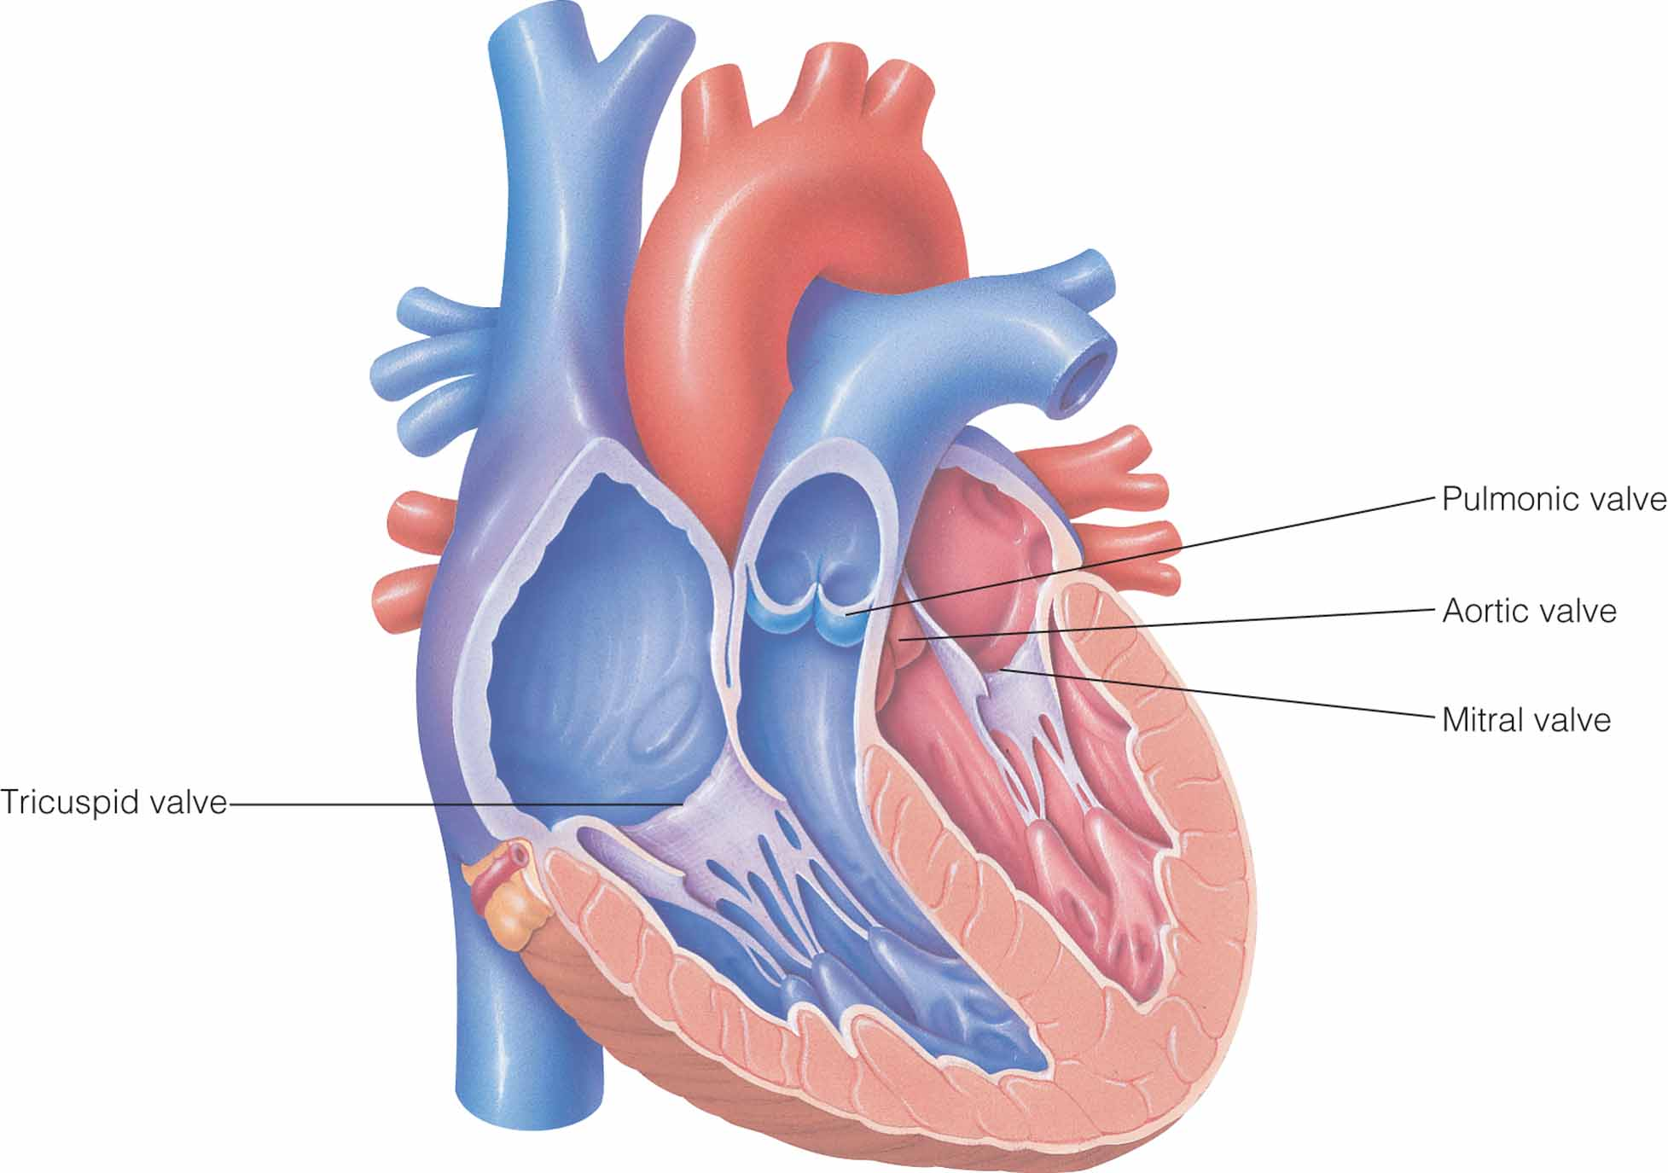
Valves of the heart.
Notes:
14

Slide 15
Structure of the wall of the Heart:
Walls of the heart are composed of a thick layer of cardiac muscles, the
myocardium , covered externally by the epicardium and lined internally by the endocardium.
• Walls of the atrial portion of the heart are thin.
• Walls of the ventricular portion of the heart are thick.
Pericardium.
The heart and roots of the great vessels are enclosed by a fibroserous sac
called pericardium. Its function is to restrict excessive movements of the
heart as a whole and to serve as a lubricated container in which different
parts of the heart can contract. Pericardium consists of two layers: outer
fibrous and inner serous (Parietal and Visceral layers ).
Myocardium
The myocardium (muscular tissue of the heart) is the main tissue
constituting the walls of the heart. It consists of three types of muscle
fibres:

Slide 16
• Cardiac muscles forming the walls of the atria and ventricles –
contractile unit of the heart.
• Muscle fibers forming the pacemaker which is the site of origin of cardiac impulse.
• Muscle fibers forming the conducting system which transmits the impulse to the various parts of the heart .
Endocardium
Endocardium is a thin, smooth and glistening membrane lining the
myocardium internally. It consists of a single layer of endothelial cells.
The endocardium continues as the endothelium of great vessels opening
in the heart.

Slide 17
Normal Impulse Conduction

Slide 18
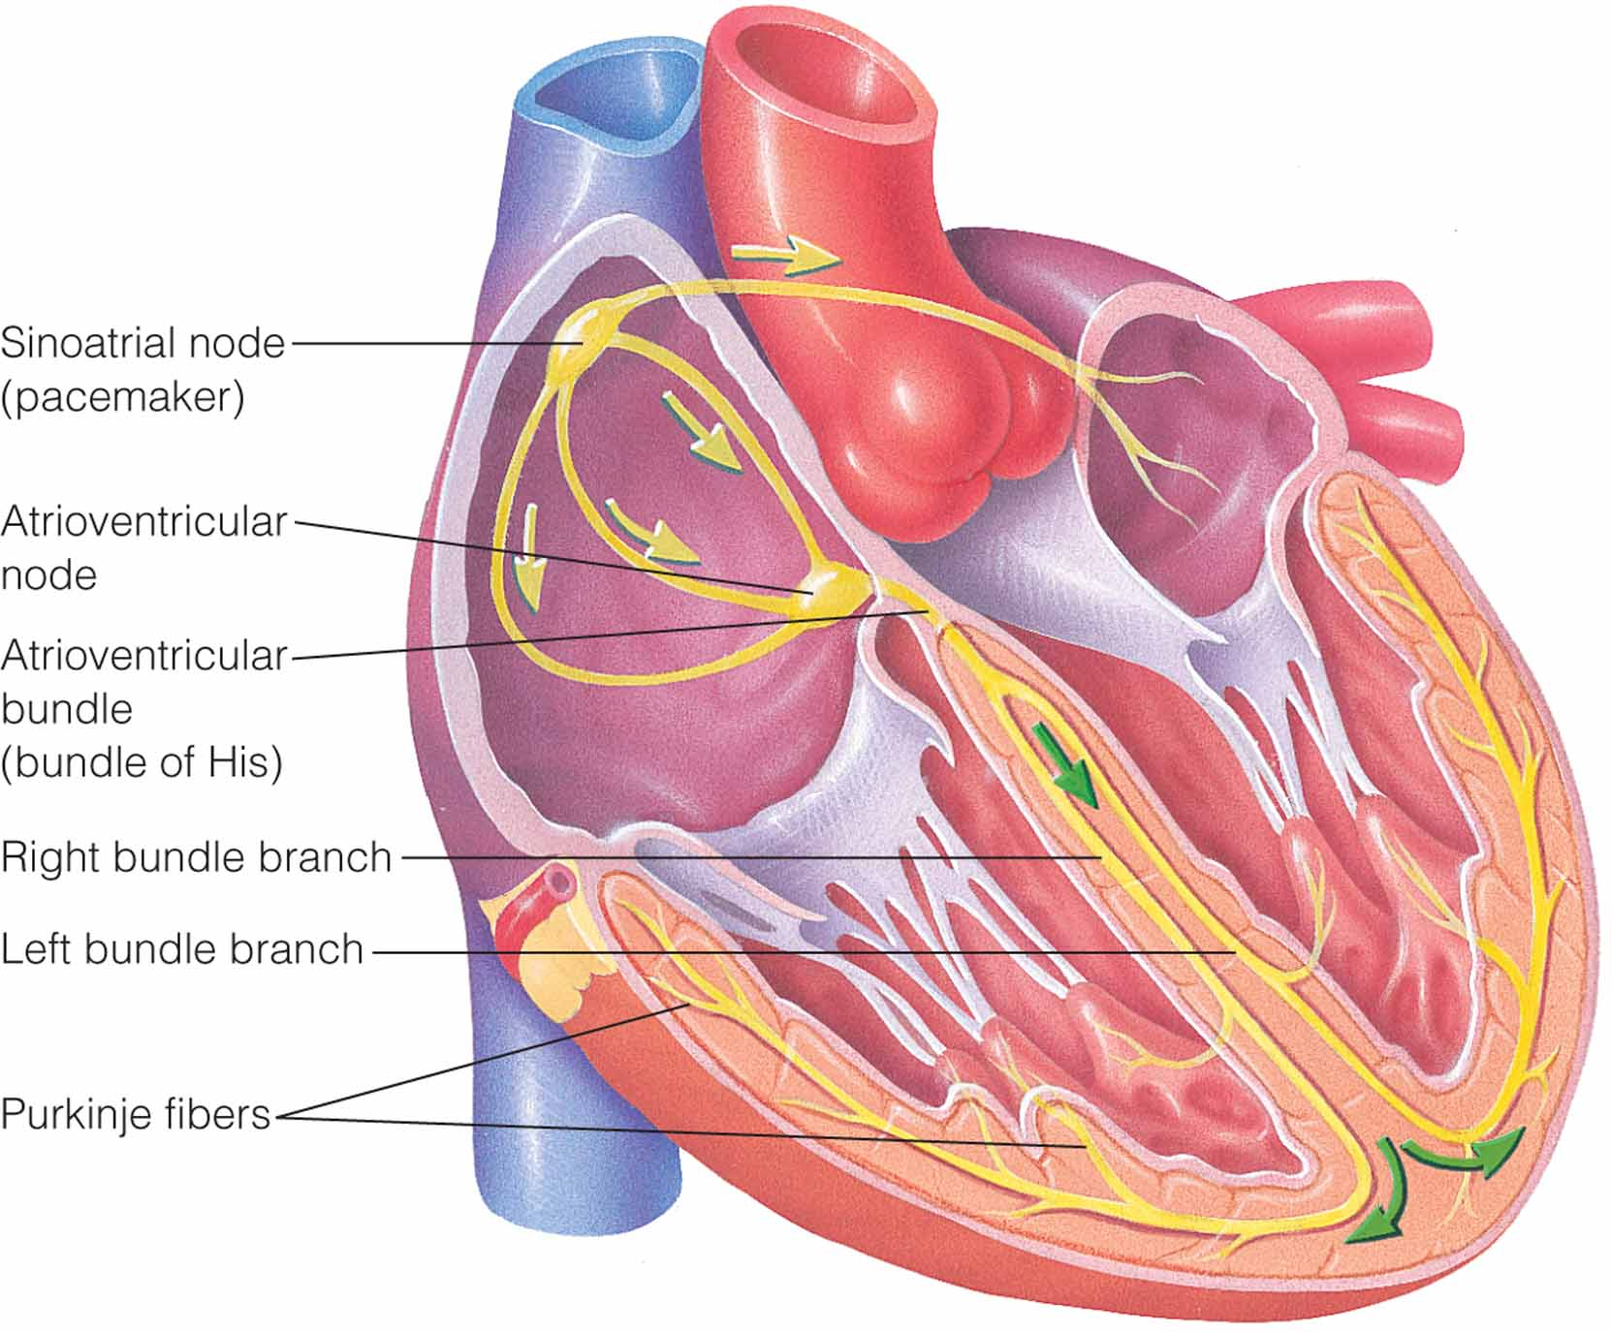
Conduction system of the heart.
Notes:
18

Slide 19
The conducting system of the heart consists of specialized fibres of the
heart muscle present as the sinoatrial node, interatrial tract, internodal
tracts, the atrioventricular (AV) node, the AV bundle of His and its right
and left terminal branches, and the subendocardial plexuses of Purkinje
fibers.
1. Sinoatrial node.
Sinoatrial (SA) node is located in the wall of right atrium, just to the right
of the opening of superior vena cava. Spontaneous rhythmical electrical
impulses arise from the SA node and spread in all directions to
• Cardiac muscles of atria,
• Interatrial tract to left atrium and
• Internodal tracts to AV node.

Slide 20
2. AV node.
The AV node is strategically located just beneath the endocardium on the
right side of lower part of atrial septum, near the tricuspid valve. It is
stimulated by the excitation wave that travels through internodal tracts
and atrial myocardium. From it, the cardiac impulse is conducted to
ventricles by the AV bundle.
3. AV bundle of his.
The AV bundle arises from the AV node, descends through the fibrous
skeleton of the heart and divides into right bundle branch (RBB) for right
ventricle and left bundle branch (LBB) for the left ventricle. The branches
break up and become continuous with the plexus of Purkinje fibres.
6. Purkinje fibres.
These are spread out deep to the endocardium and reach all parts of the
ventricles, including the bases of papillary muscles.

Slide 21
Cardiac cycle
The heart as a pump can be considered actually comprising of two
separate pumps in the series: a right heart that pumps the blood through
the lungs and a left heart that pumps the blood through the peripheral
organs.To act as a pump, the heart contracts and relaxes rhythmically. The terms
systole (contractile phase) and diastole (relaxation phase) usually refer to
ventricular events but may be prefixed by ‘atrial’ to refer to atrial
contraction and relaxation. The cardiac cycle, thus includes both electrical and mechanical events that occur from the beginning of one heart beat to the beginning of the next.

Slide 22
Cardiac Cycle
Systole
Contractile phase of heart
Electrical and mechanical changes
E.g. blood pressure changes
E.g. blood volume changes
Diastole
Relaxation phase of heart
Takes twice as long as systole
E.g. resting HR = 60
Systole = 0.3 s
Diastole = 0.6 s

Slide 23
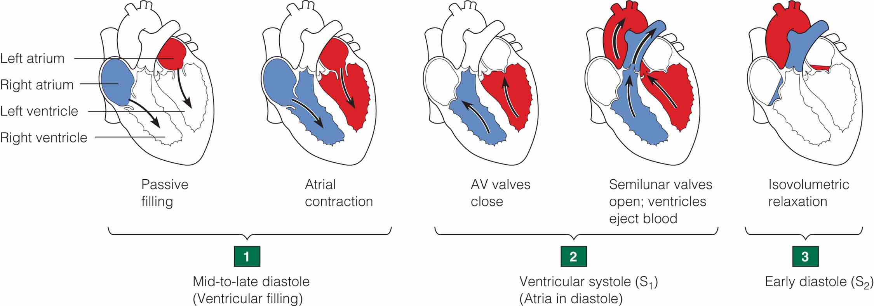
The cardiac cycle.
Notes:
23

Slide 24
The electrocardiogram ECG
It records the electrical events that precede and initiate the corresponding mechanical events as:
• P wave is caused by spread of depolarization through the atria, and this
is followed by atrial contraction.
• QRS waves which appear 0.16 s after the onset of P wave are caused by
depolarization of the ventricles which initiates contraction of the ventricles.
• T wave represents the stage of repolarization of the ventricles at which
time the ventricular muscle fibres begin to relax. Therefore, T wave
occurs slightly before the end of ventricular contraction.

Slide 25
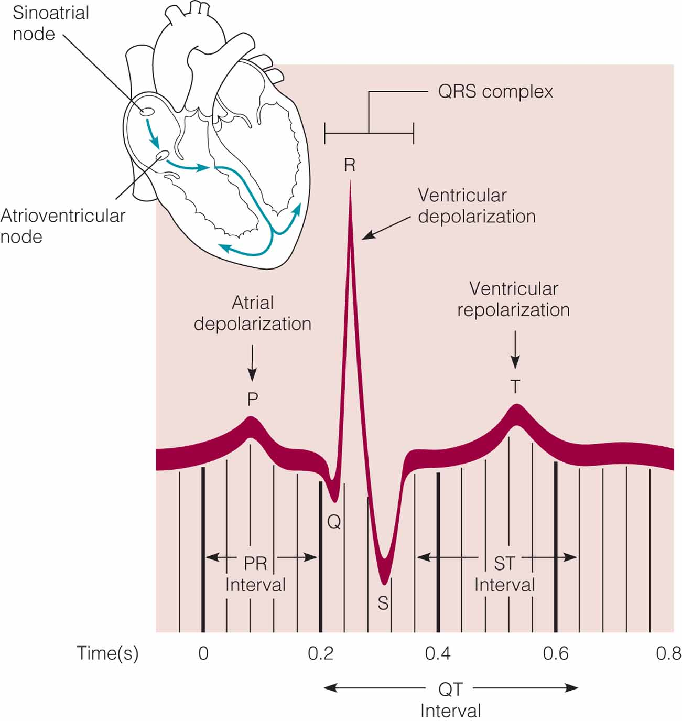
Electrocardiogram wave.
Notes:
25

Slide 26
Diagnostic use of the ECG
ECG abnormalities may indicate coronary heart disease
ST-segment depression may indicate myocardial ischemia

Slide 28
Heart Rate
Range of normal at rest is 50 – 100 b.m
Increases in proportion to exercise intensity
Max. HR is 220 – age
Medications may change normal response

Slide 29
Cardiac Function
Stroke volume
Amount of blood that is ejected with each heartbeat
Cardiac output
Amount of blood ejected from the left ventricle over 1 minute
Cardiac index
Measurement accounting for an individual’s weight when evaluating the pumping action of the heart

Slide 30
Pumping Action of the Heart
Preload volume overload
Afterload pressure overload
Cardiac output: stroke volume x heart rate
Blood pressure: cardiac output x systemic vascular resistance

Slide 31
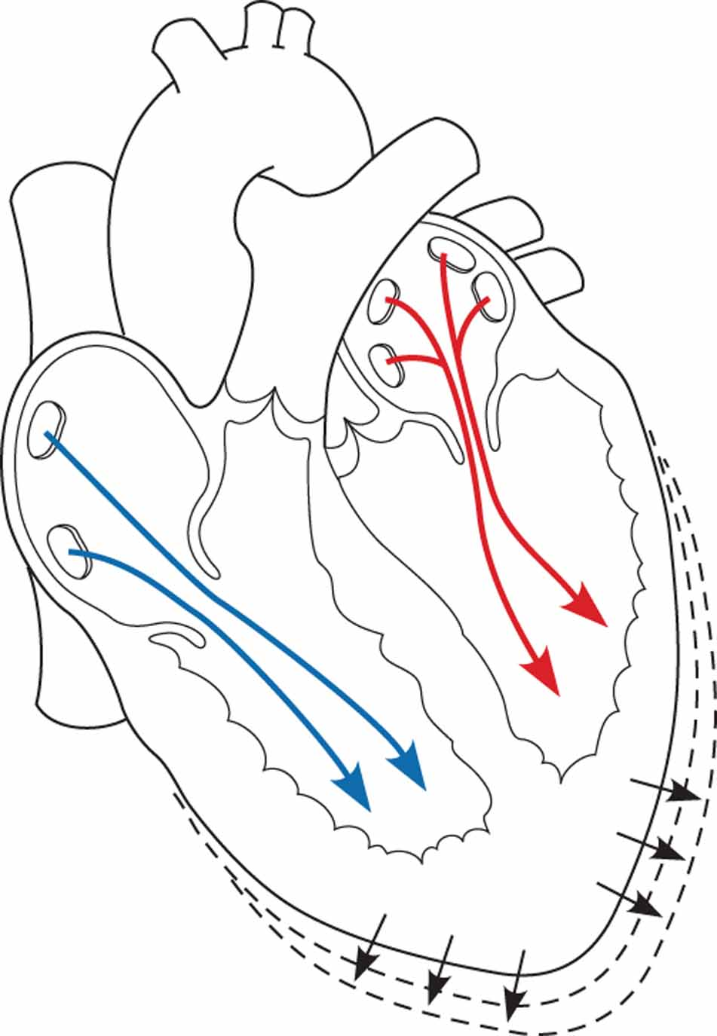
A. Preload is related to the amount of blood and stretching of the ventricular myocardial fibers.
A
Notes:
31

Slide 32
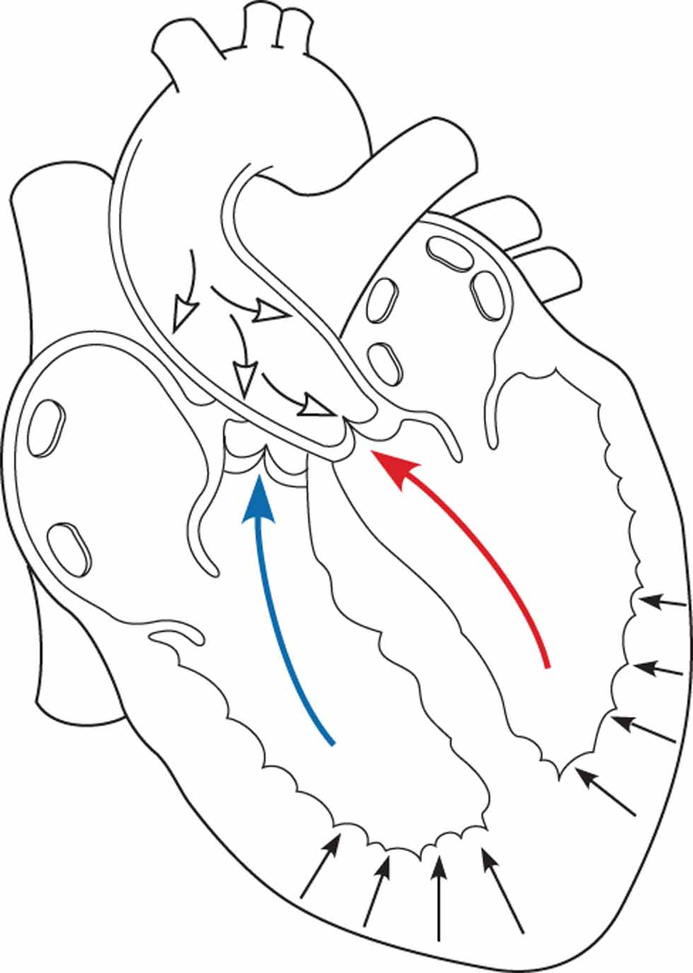
(continued) B. Afterload is the pressure that the ventricles must overcome in order to open the aortic and pulmonic valvular cusps.
B
Notes:
32

Slide 33
Cardiac Function Control
Intrinsic
Preload
Extrinsic
ANS
Electrolytes
Temperature
Humoral/Chemical
Notes:
Instructor Notes:

Slide 34
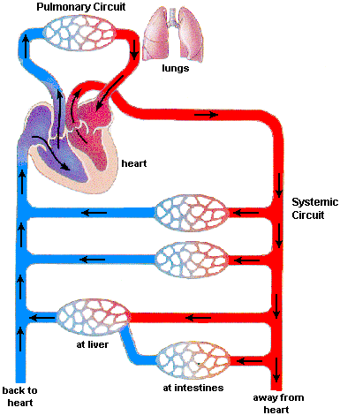
Intrinsic
Preload
Venous return to Heart
70 % blood volume
Low Pressure
Notes:
Instructor Notes:
Good opportunity to recap and re-explain
Define Starling’s Law – The more the myocardium is stretched, to a point, the more forceful the subsequent contraction will be.

Slide 35
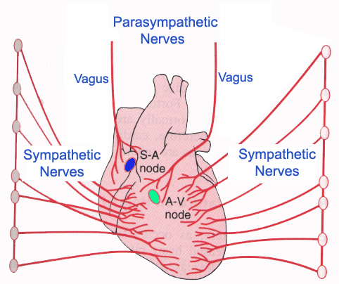
Extrinsic influences on CO
Autonomic Nervous System
Notes:
Instructor Notes:
Explain how the sympathetic and parasympathetic nervous systems work in a check and balance manner regulating heart rate to meet the body’s metabolic demands
The parasympathetic nervous system is like a brake pedal and the sympathetic nervous system is like an accelerator pedal.
e.g. giving atropine inhibits the effects of the parasympathetic nervous system and results in an increase in heart rate (like taking your foot off the brake)
Sympathetic NS – Fight or Flight, Parasympathetic NS – Feed or Breed – they work to balance each other.

Slide 36
Extrinsic influences on CO
Electrolytes
K⁺ - Increase will decrease rate and force
Na⁺ - Increase will decrease force
Ca⁺⁺ - Increase will increase force
Temperature
Low - Decreased rate
Hi - Increased rate,Increased force
Humoral/Chemical
Catecholamines – increase rate and force
ADH – increased secretion increases preload
Acids – increases in acids decreases function
Notes:
Instructor Notes:
Discuss common cause of Hyperkalemia – e.g. patients on renal dialysis with chronic or acute metabolic acidosis; diabetic ketoacidosis, etc

Slide 37
Heart Sounds and Murmurs
The normal heart sounds are usually described by the syllables “lubb” and “dupp.” The first is a longer, lower pitched sound that occurs at the start of ventricular systole. It is probably caused by a combination of things, including closure of the atrioventricular valves. The second, or “dupp,” sound is shorter and sharper. It occurs at the beginning of ventricular relaxation and large part of it is due to sudden closure of the semilunar valves. Some abnormal sounds called murmurs are usually due to faulty action of the valves. For example, if the valves fail to close tightly and blood leaks back, a murmur is heard. Another condition giving rise to an abnormal sound is the narrowing (stenosis) of a valve opening. The many conditions that can cause abnormal heart sounds include congenital defects, disease, and physiological variations. A murmur due to rapid filling of the ventricles is called a functional (flow) murmur; such a murmur is not abnormal. An abnormal sound caused by any structural change in the heart or the vessels connected with the heart is called an organic murmur.

Slide 38
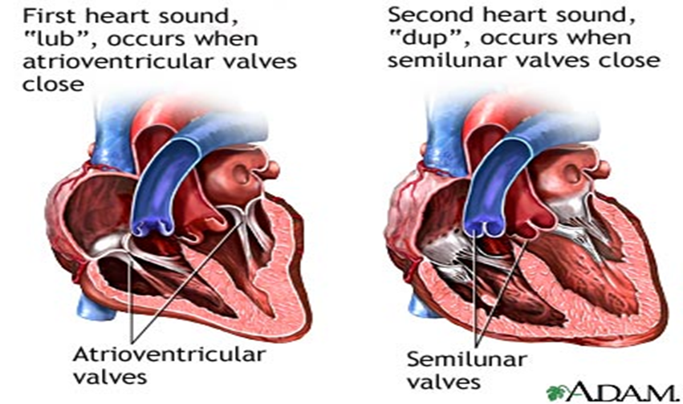

Slide 39
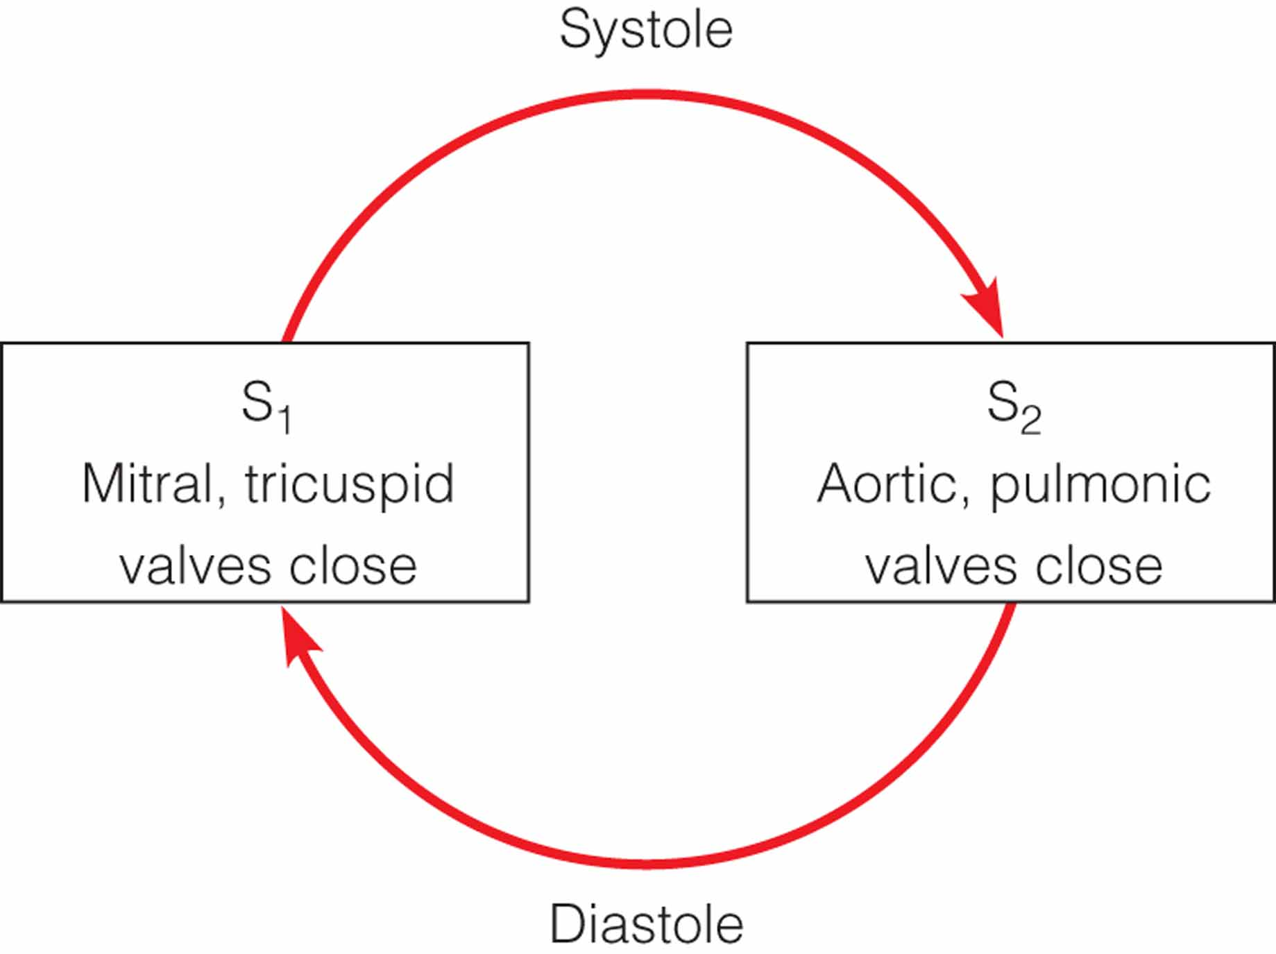
Heart sounds in systole and diastole.
Notes:
39

Slide 40
Heart Failure
When the heart is unable to pump the volume it receives it is said to be in failure
Right Sided
Left Sided
Notes:
Instructor Notes:
Discuss causes of acute pulmonary edema
Discuss exacerbations of chronic left sided failure
Discuss pathophysiology and presentation of chronic right sided failure

Slide 41
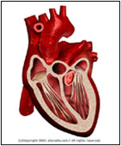
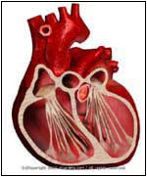
Heart Failure
Causes
Pump Failure
Notes:
Normal heart vs. enlarged heart

Slide 42
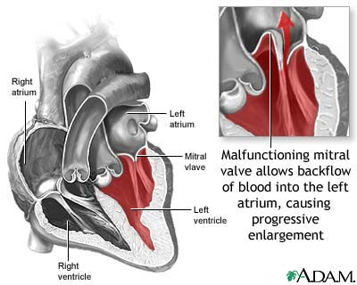
Heart Failure
Causes
Cardiac ischemia
Hypertensive event
Rate related
Tachycardia
Bradycardia
Valvular disease
Prolapse
Rupture
Notes:
Instructor Notes:
Discuss NTG’s role in the management of APE – Ntg acts as a vasodilator, therefore making the venous system a “toilet” that reduces the amount of extra fluid in and around the heart…decreasing pulmonary edema
Discuss the role of Furosemide and how it works + why it’s falling out of favour for most cases of APE unless there’s clear evidence of hypervolemia – Furosemide(Lasix) is a loop diuretic…the kidneys sense the extra fluid, and put into motion the removal of excess fluid(H20) from the body…. This causes a patient that is already stressed to feel and urge to urinate, regularly!!! The patient is SOB, and now feel urge to urinate, and need to WALK to Bathroom, they are now on a downward roller coaster…they need to be catheterised, another stressful procedure to control urges to urinate…not a really good treatment for a patient that needs to work at breathing ONLY.
Discuss cardiac asthma and treatment with salbutamol: pros/cons- As a bronchodilator, Ventolin opens up the larger airways, to treat Asthma. When given to CHF’rs,may make patient feel better initially, but will end up making patient worse…actually opening up the flood gates into the lungs, making the patient rebound initially and then make a turn for the worse. The fluid rushes into the lungs and the patient will drown in their own fluid.

Slide 43
RISK FACTORS OF HEART ATTACK Be Old
Relative risk of CHD increases with age

Slide 44
Have a family history of CHD
The more blood relatives one has with CHD, and the younger they are (were), the higher the relative risk

Slide 45
Heredity influences your cardiovascular fitness
Genetics is important - pick your parents carefully
High/low responders to training
If you do the process, the product will follow, within your limitations

Slide 46
Be a Man
Males have 5-6 times the relative risk of CHD of females
Why? Estrogen may be protective

Slide 47
Unalterable Risk Factors for CHD
Age
Family History
Sex

Slide 48
Alterable Risk Factors
Things you can do something about…

Slide 49
Be fat
Obesity increases CHD risk
How much fat is too much?
Males - > 25%
Females > 30%

Slide 50
Eat a high fat diet
High fat foods increase plaque within arteries and contribute to atherosclerosis

Slide 51
Have High Cholesterol
Total cholesterol/HGH ratio above:
Males – 4.5/1
Females – 4/1
Increases relative risk of CHD

Slide 52
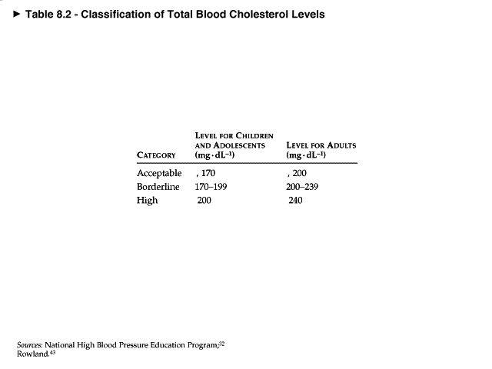

Slide 53
Have High Blood Pressure
High blood pressure forces the heart to work harder
How high is too high?
> 140/90

Slide 54
Smoke
Smokers are more likely to die of heart attack than cancer
Smoking is the single most important alterable risk factor

Slide 55
Have Other Hypokinetic Diseases
Diabetes
Ulcers
Obesity

